Slide 1

SLP Pass & Custom Instruction
In LLVM Compiler
CSIE5054
Advanced Compiler Design
NTU CSIE5054 Advanced Compiler Design

Slide 2
Outline
Introduction of SLP
Superword-level parallelism
SLP & Loop-Aware SLP
SLP in LLVM vs. GCC
SLP Overview in LLVM
Cost Model in SLP Pass
Cost Difference between RISC-V and ARM NEON
Call Graph of Cost Calculation(non-GEP && GEP)
Support vload/vstore Instruction with offset in LLVM Backend
Describing instructions
Matching multiple DAG nodes
Example

Slide 3
Introduction of SLP

Slide 4
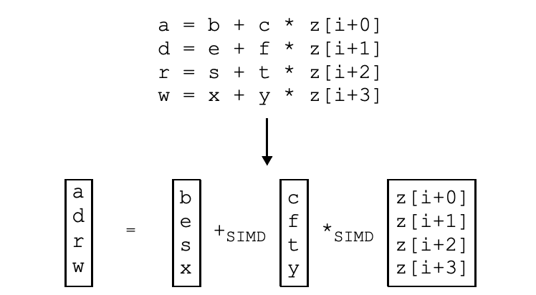
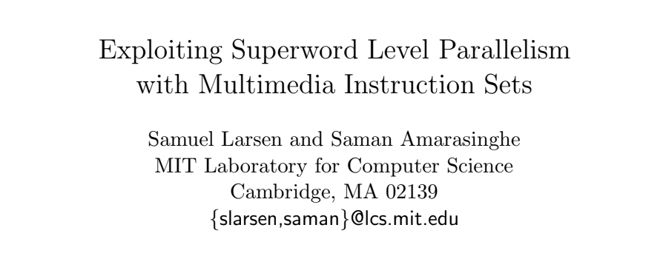
Superword-level parallelism (cont.)
Superword Level Parallelism is proposed in 2000.
Find parallelism within a basic-block
Isomorphic and independent statements can be vectorized.

Slide 5
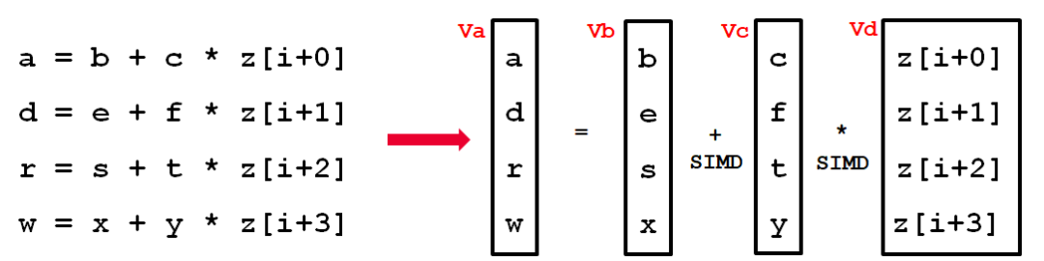
Superword-level parallelism (cont.)
2 Auto-Vectorizers: Loop Vectorizer Pass & SLP Vectorizer Pass
Both are enabled by default (-Os, -O2, -O3)
It can be disabled through clang using the command line flag:
clang -fno-slp-vectorize file.c
Pass Pipeline: <Loop Vec> then <SLP Vec>
llvm/lib/Passes/PassBuilderPipelines.cpp

Slide 6
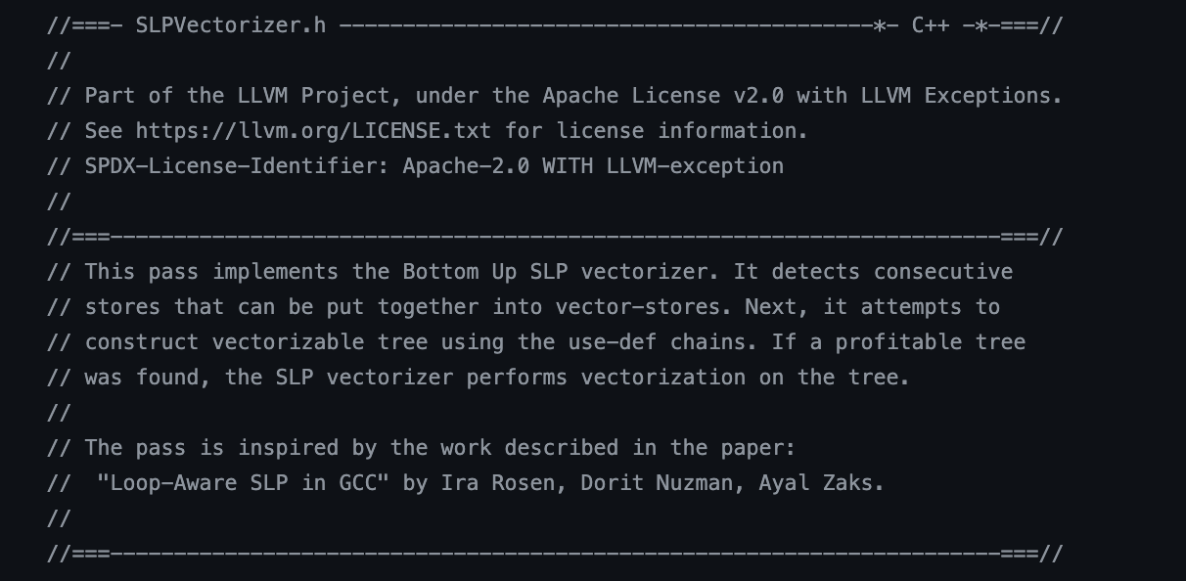
SLP & Loop-Aware SLP
Original SLP
Find parallelism within basic-block
LLVM’s SLP Vectorizer is inspired by Loop-Aware SLP in GCC
Focus on SLP opportunity “in” loops, rather than any basic-block.
llvm/include/llvm/Transforms/Vectorize/SLPVectorizer.h

Slide 7
SLP in LLVM vs. GCC
Loop-
vectorize
SLP-
vectorize
Loop-
vectorize
SLP-
vectorize
LLVM
GCC
Different Passes
Find parallelism within any basic-block
Integration into the same pass
Find SLP opportunity in loops, rather than any basic-block.

Slide 8
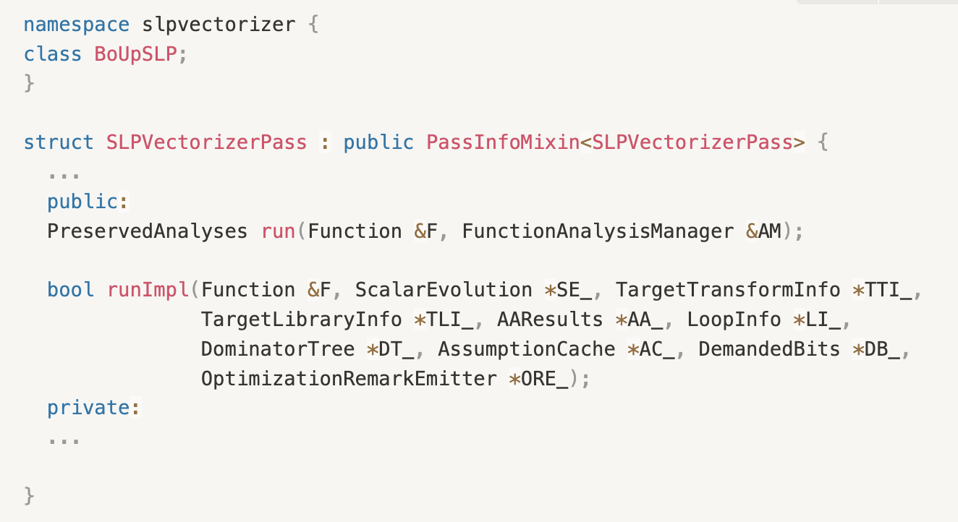
SLP Overview - Header
inherit from the PassInfoMixin!
Run is an Entry point for each pass
Call this function
llvm/include/llvm/Transforms/Vectorize/SLPVectorizer.h
Notes:
New pass manager: there is no explicit interface
All LLVM passes inherit from the CRTP mix-in PassInfoMixin<PassT>.
The pass should have a run() method which returns a PreservedAnalyses and takes in some unit of IR along with an analysis manager.

Slide 9
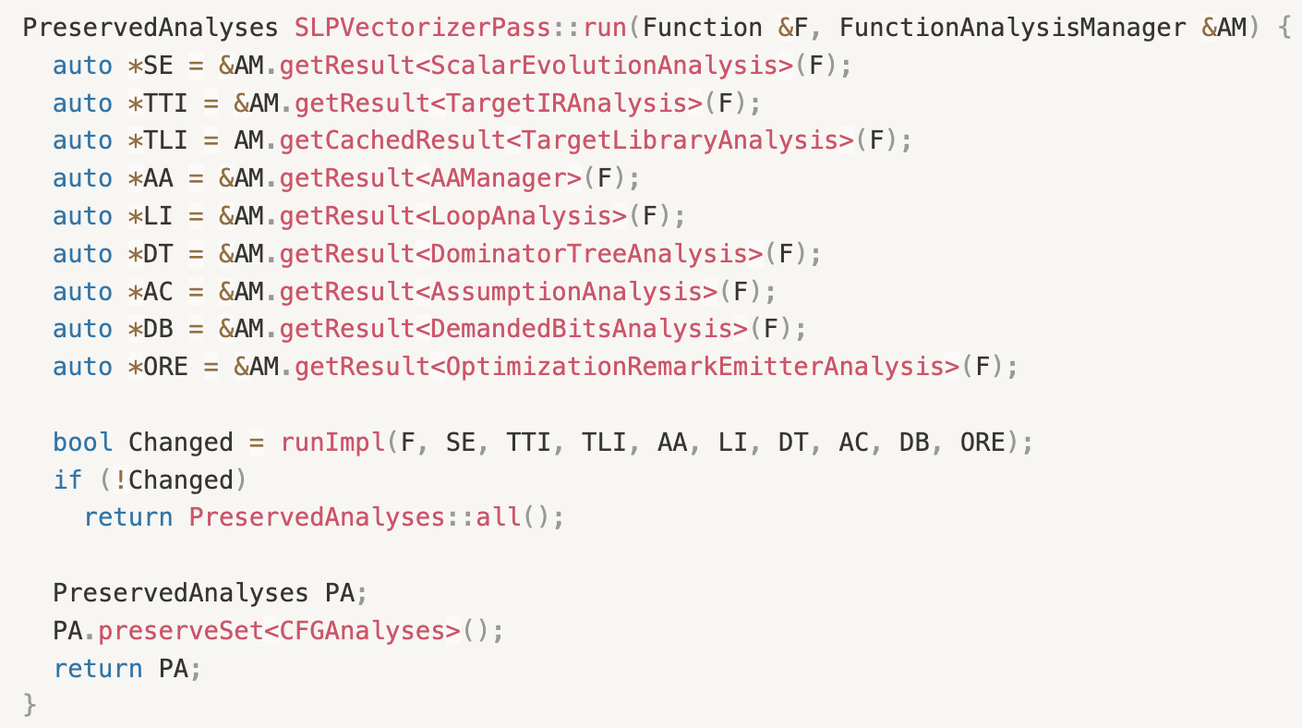
SLP Overview - run
time-saving: because nothing changes,
there is no need to reanalyze code.
llvm/lib/Transforms/Vectorize/SLPVectorizer.cpp

Slide 10
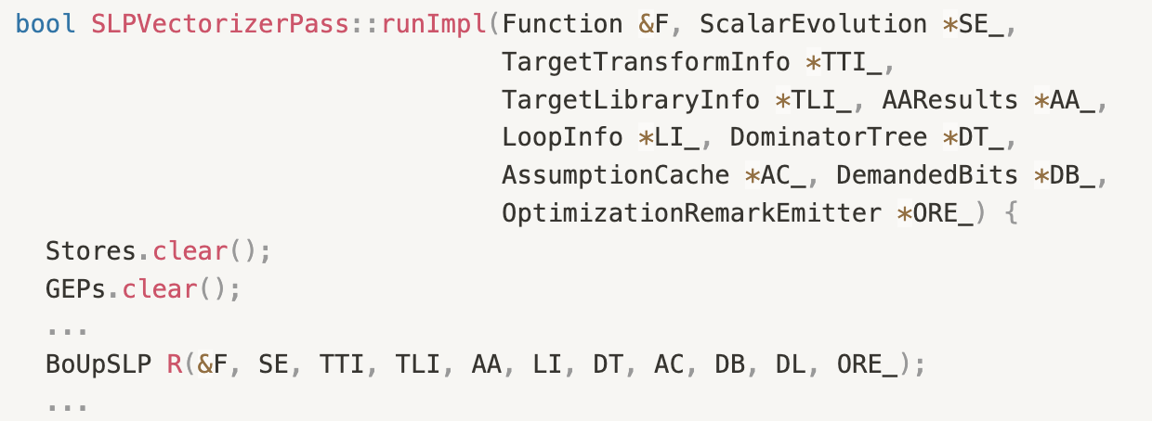
SLP Overview - runImpl
Clear the previously stored information.
Initialize the BoUpSLP object R.
llvm/lib/Transforms/Vectorize/SLPVectorizer.cpp

Slide 11
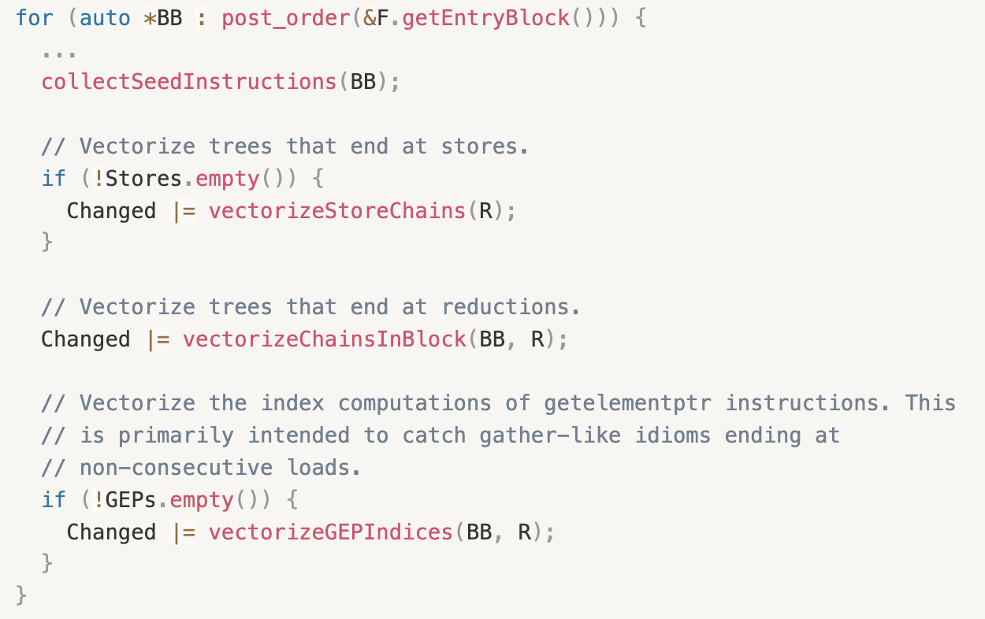
SLP Overview - runImpl
llvm/lib/Transforms/Vectorize/SLPVectorizer.cpp
Find all candidate instructions for vectorization
three different scenarios

Slide 12
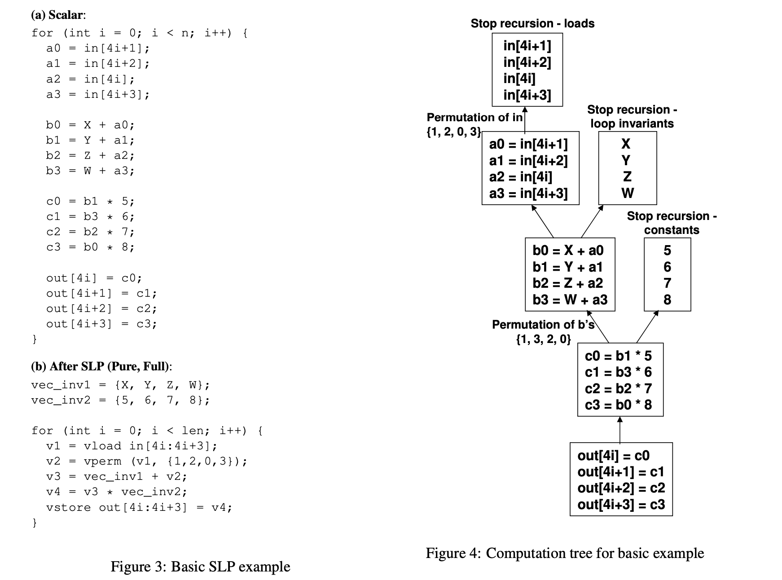
SLP Overview - View Tree
Loop-Aware SLP in GCC

Slide 13
LLVM Cost Model
in SLP Pass

Slide 14
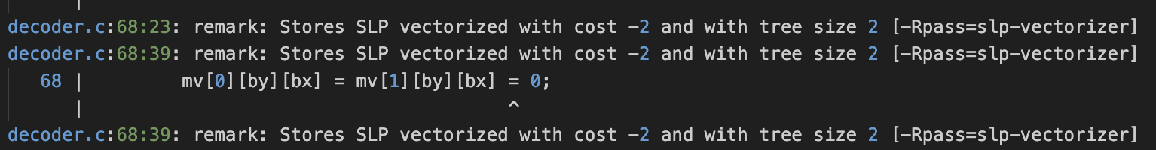
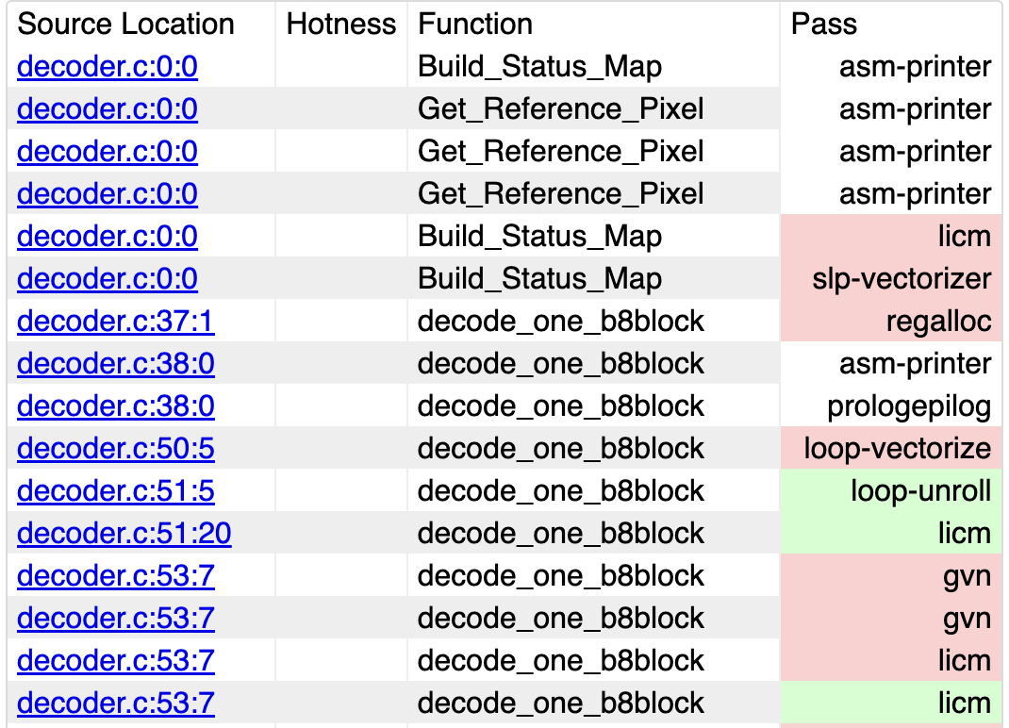
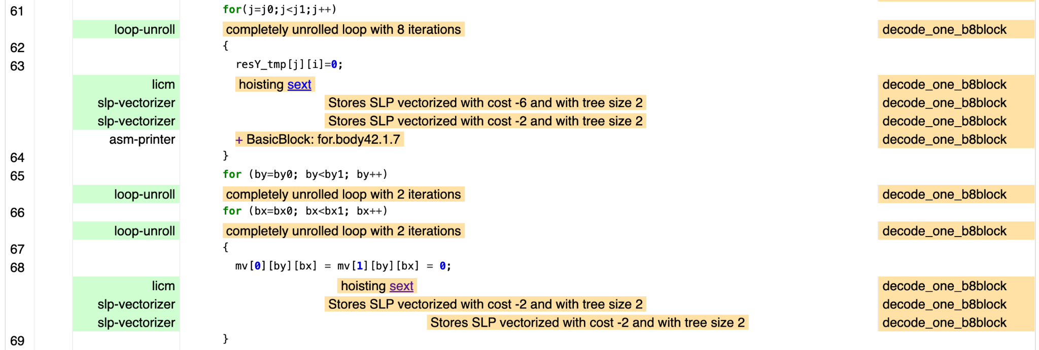
Cost Difference between RISC-V and ARM NEON
-Rpass=slp-vectorizer identifies SLP patterns that were successfully vectorized.
https://llvm.org/docs/Remarks.html#remark-diagnostics

Slide 15
Call Graph of Cost Calculation(non-GEP && GEP)
After building a tree
GetTreeCost
static_cast<T *>(this)
ScalarCost
Some Interface
Case: Instruction type
VectorCost
Some Interface
BaseT::
getPointers
ChainCost
AArch::get
ArithmeticInstrCost
GetCostDiff
getEntryCost
(Non-GEP)
GetGEPCostDiff
GetGEPCosts
getPointers
ChainCost
(GEP)
BaseT::
getGEPCost
SpillCost
RISCV::
getPointers
ChainCost
RISCV::get
ArithmeticInstrCost
ExtractCost
SLP
TTI
TTIImpl
LLVM 19.1.0-rc3(Aug 20, 2024)

Slide 16
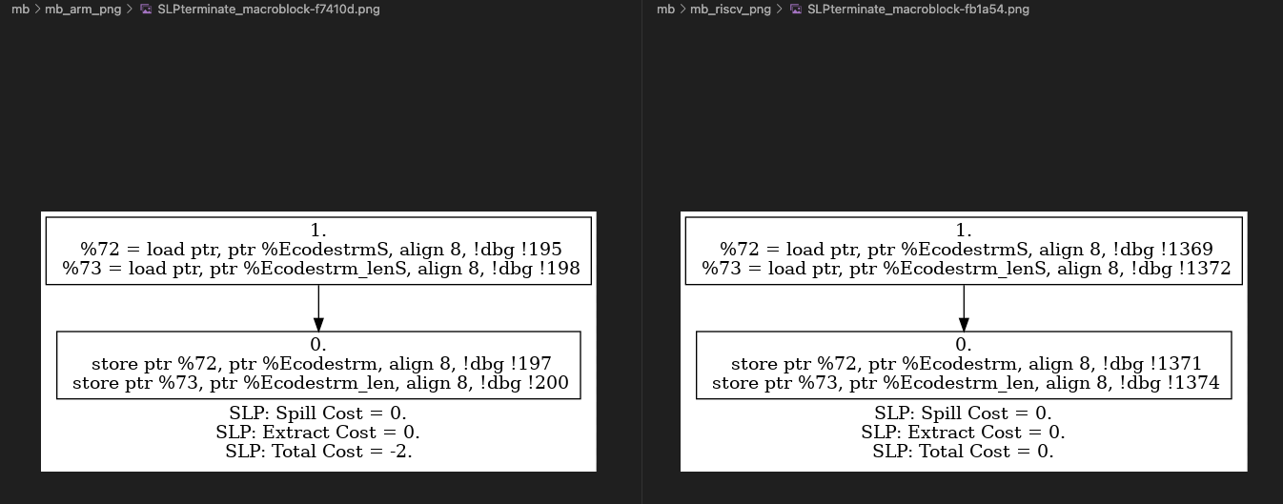
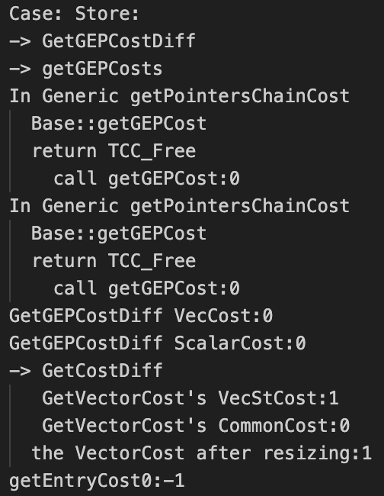
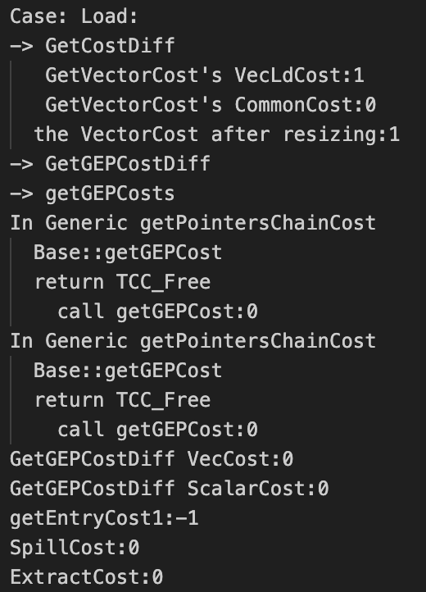
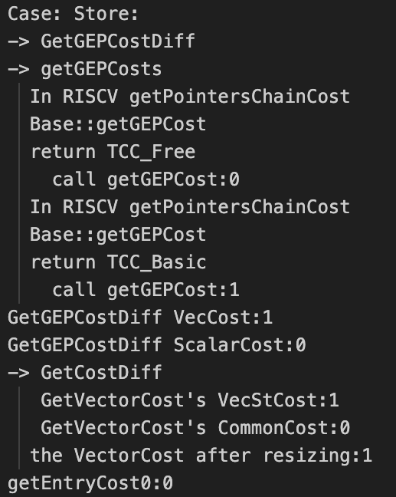

AArch64
RISCV

Slide 17
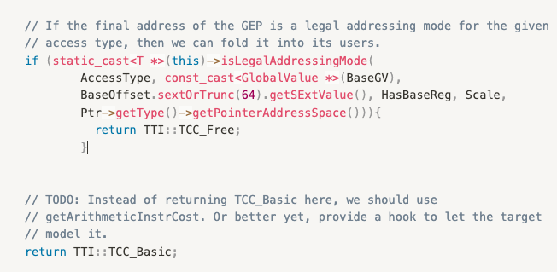
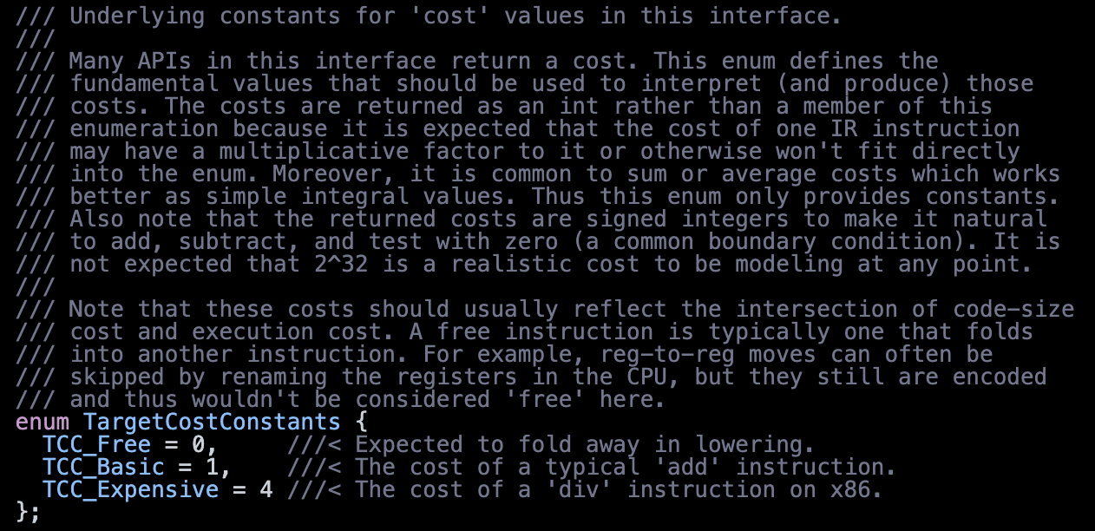
TargetCostConstants(TTI::TCC)
/llvm-project/llvm/include/llvm/Analysis/TargetTransformInfoImpl.h
Notes:
下面再貼一下SLP 為什麼要加offset Scale即可

Slide 18
The conditions for obtaining TCC_FREE in NEON
4 different legal addressing mode formats
Register + 9 bits signed offset | LDR X0, [X1, #-100]
Register + 12 bits unsigned imm * NumBytes | LDR W0, [X1, #400] (Offset = imm12 * NumBytes)
Register1 + Register2 | LDR X0, [X1, X2]
Register1 + SIZE_IN_BYTES * Register2 | LDR X0, [X1, X2, LSL #3]
Notes:
A64指令集 Load/Store 指令: https://ithelp.ithome.com.tw/m/articles/10351298

Slide 19
If RV64 had the same addressing mode as Neon
For Scale == 0, the Offset range is: -28 to 14,168
For Offset == 0, the Scale range is: 1 to 8
Cost/Time:
Cost:
Before: 1518
After: 1812
Time:
Before: 279
After: 322
Vector Instruction:
Vector Instructions:
Before: 652
After: 792

Slide 20
Support vload/vstore Instruction
with offset in LLVM Backend

Slide 21
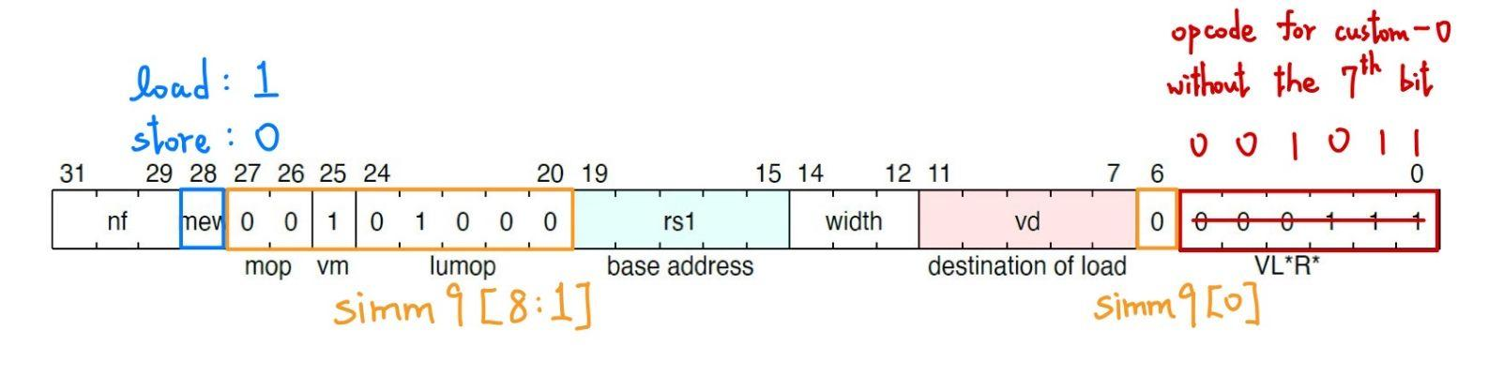
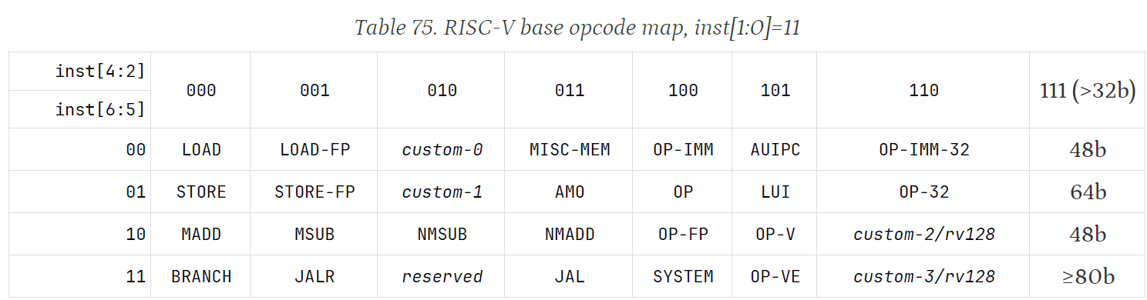
9-bit Imm Offset Coverage
Encoding
Notes:
阿邦：這邊bit應該是取5-th bit instead of 6-th bit

Slide 22
Describing instructions: Overview
Goal: Add a set of custom vector load/store instructions to LLVM backend
We define them in /llvm-project/llvm/lib/Target/RISCV/RISCVInstrInfoMTK_V.td
What we need to specify
Operands
Assembly string
Instruction pattern match

Slide 23
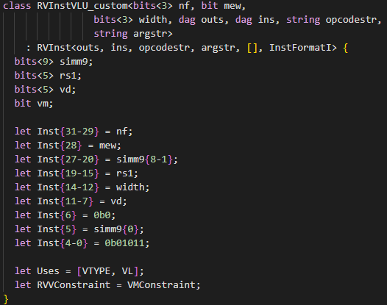
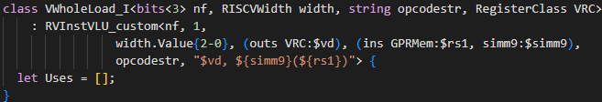
Describing instructions: Operands/Assembly String
For Vector load with 9-bit signed offset
List of definitions or outputs (’outs’)
List of uses or inputs (’ins’)
Operand class:
Register class
Immediate
More complex operands (e.g. reg + imm for load/store)

Slide 24
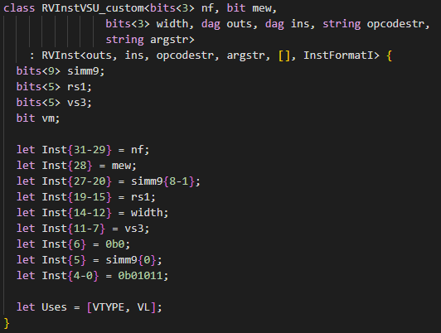
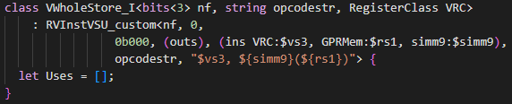
Describing instructions: Operands/Assembly String
For Vector store with 9-bit signed offset
List of definitions or outputs (’outs’)
List of uses or inputs (’ins’)
Operand class:
Register class
Immediate
More complex operands (e.g. reg + imm for load/store)

Slide 25


Describing instructions: Selection Patterns
Matches nodes in the Selection DAG
Nodes get turned into MachineInstrs during ISel
If pattern is omitted, selection needs to be done in C++
Syntax:
Nodes have DAG operands, with ’MVT’ type (e.g. i32)
Map DAG operands to MI operands

Slide 26
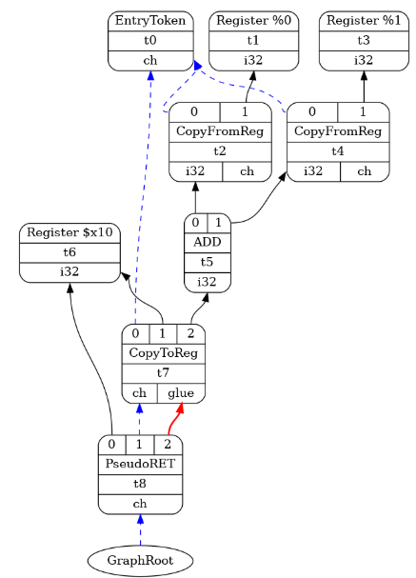
A Look at a SelectionDAG graph
Graph representation
Operations as Node
Could be target-dependent or independent
Semantics defined by LLVM
Node id.
MVT(Machine Value Type)
Operation
Operands
Dependency as Edge
Data
Order (chain edge)
Scheduling (glue edge)

Slide 27
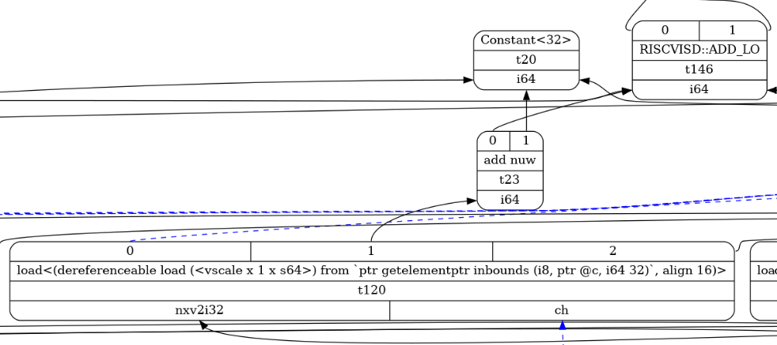
Matching multiple DAG nodes
SelectionDAG before machine instruction selection
Green node outputs base address
Blue node outputs offset
add operation is needed to calculate the memory address

Slide 28
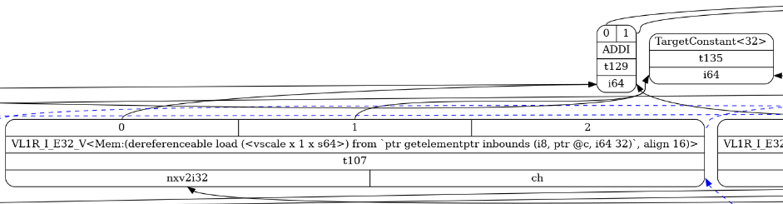
Matching multiple DAG nodes
SelectionDAG after machine instruction selection
The machine instruction can directly greps the base address and offset

Slide 29
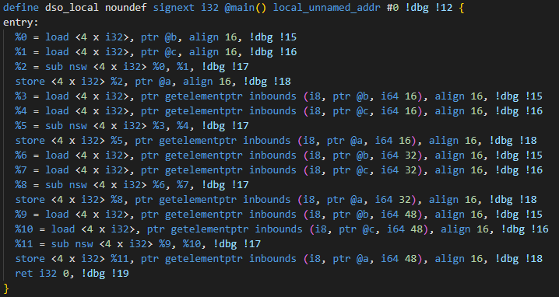
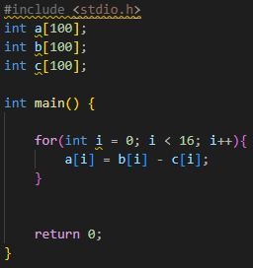
Example
Enable RISCV Vector Extension to generate vector type
example.c
example.ll

Slide 30
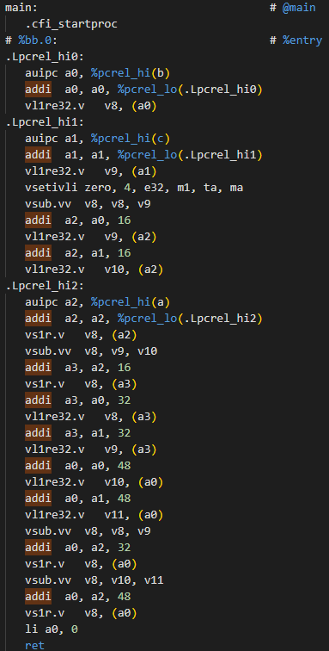
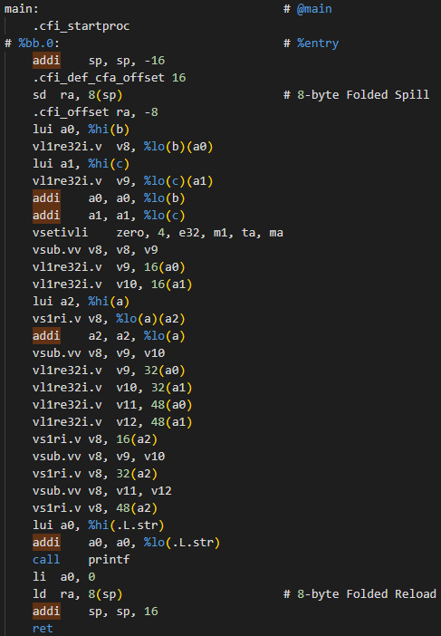
Example
Compare the assembly before/after custom instruction is added
before_test.s
after_test.s

Slide 31
LLVM Loop Vectorizer
CSIE5054
Advanced Compiler Design
NTU CSIE5054 Advanced Compiler Design

Slide 32
Outline
Loop vectorizer overview
LCSSA
Loop vectorizer structure
Cost Model
Interesting case ( PHI instruction )

Slide 33
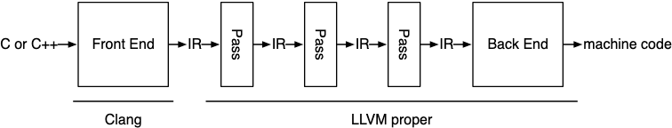
Loop vectorizer Overview
The LLVM optimizer is organized as a pipeline of distinct optimization and analysis passes.
Loop vectorize is one of them.
https://www.cs.cornell.edu/~asampson/blog/llvm.html

Slide 34


Loop vectorizer Overview
Widen instructions in loops to operate on multiple consecutive iterations.

Slide 35
Loop vectorizer Overview
Widen instructions in loops to operate on multiple consecutive iterations.
A[i] | A[i+1] | A[i+2] | A[i+3]
B[i] | B[i+1] | B[i+2] | B[i+3]
Vector Registers

Slide 36
Loop vectorizer Overview
Vector Instructions
A[i] | A[i+1] | A[i+2] | A[i+3]
B[i] | B[i+1] | B[i+2] | B[i+3]
Vector Registers

Slide 37
Loop vectorizer Overview
Terminology:
Vectorization Factor ( VF )
Target Transform Info ( TTI )

Slide 38
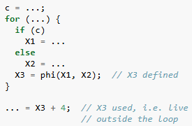
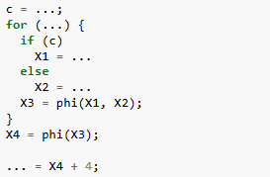
LCSSA
Loop-closed SSA ( LCSSA ):
A program is in Loop Closed SSA Form if it is in SSA form and all values that are defined in a loop are used only inside this loop.
Not LCSSA
LCSSA

Slide 39
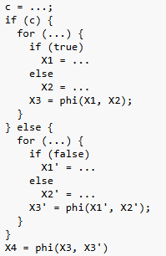
LCSSA
An simple example: Loop-unswitch
Notes:
太厲害了啊
我覺得就衝了

Slide 40
Loop vectorizer Structure
When we try to vectorize a loop ……
Legality Check
Build vectorization recipes
Find the best Plan
Execute the Plan

Slide 41
Legality Check
First, we have to check if it is legal to vectorize a loop, and to what vectorization factor.
Two main kinds of checks:
Memory checks : Checks if vectorization will change the order of memory accesses in a way that will change the correctness of the program.
Scalars checks : Checks for a number of different conditions, such as the availability of a single induction variable, that all types are supported and vectorize-able.
https://llvm.org/doxygen/classllvm_1_1LoopVectorizationLegality.html#details

Slide 42
Loop vectorizer Structure
When we try to vectorize a loop ……
Legality Check
Build vectorization recipes
Find the best Plan
Execute the Plan

Slide 43
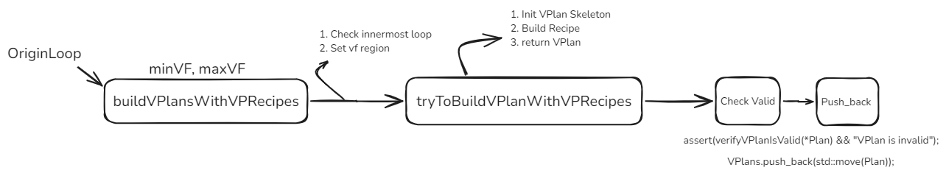
Build Vectorization Plan Recipes
Key Function:
buildVPlansWithVPRecipes
tryToBuildVPlanWithVPRecipes

Slide 44
Vectorized loop skeleton
Vector.ph
Scalar.ph
middle.block
Vector.body
for.body

Slide 45
Loop vectorizer Structure
When we try to vectorize a loop ……
Legality Check
Build vectorization recipes
Find the best Plan
Execute the Plan

Slide 46
Find the best Plan
Now, we have many VPlans corresponding to the available VFs.
We want to find the best one.

Slide 47
The cost model
In many cases vectorization is not profitable.
The cost model mainly attempt to predict the expected speedup/slowdowns due to the supported instruction set.
Use the TargetTransformInfo (TTI) to query the different backends for the cost of different operations.

Slide 48
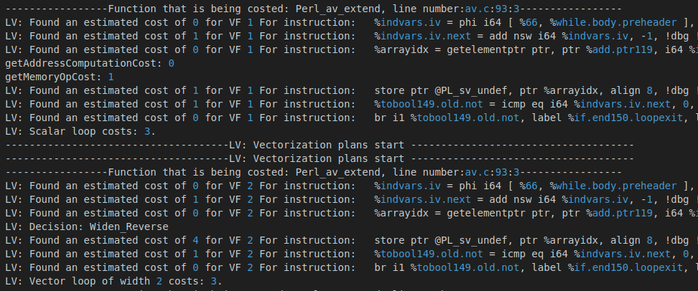
The cost model

Slide 49
The cost model

Slide 50
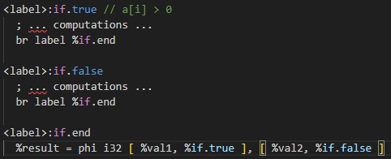
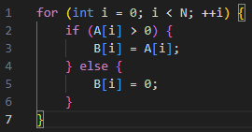

PHI instruction
Convert PHI instruction to Select instruction:
IR
C code
Convert to Select

Slide 51
PHI instruction
Convert PHI instruction to Select instruction:
a
b
a
b
c
Phi a,b
Phi a,b,c
Need 1 select instructions
Need 2 select instructions

Slide 52


PHI instruction
RISC-V use VMERGE_VVM to do this.
There are three vectors in this example:
Then the result is :

Slide 53
PHI instruction
So the cost of vectorizing a PHI instruction is :
( Numbers of select instructions ) * ( the cost of VMERGE_VVM )
Cost of VMERGE_VVM = 1 * LMUL
Real case example: ( in SPEC2006 445.gobmk)
%commonlibs.3 = phi i32 [ %inc216, %if.then215 ], [ %commonlibs.2300, %land.lhs.true205 ], [ %commonlibs.2300, %lor.lhs.false193 ]
VF | Cost | LMUL
2 | 1 | 1
4 | 1 | 1
8 | 2 | 2

Slide 54
Loop vectorizer Structure
When we try to vectorize a loop ……
Legality Check
Build vectorization recipes
Find the best Plan
Execute the Plan

Slide 55
Reference
Writing an LLVM Backend
2014 LLVM Developers’ Meeting: “Building an LLVM Backend ”
llvm/lib/Transforms/Vectorize/SLPVefctorizer.cpp
llvm/include/llvm/Transforms/Vectorize/SLPVectorizer.h
Writing LLVM Pass in 2018
Exploiting Superword Level Parallelism with Multimedia Instruction Sets
[patch] Loop-aware SLP
Loop-aware SLP in GCC

